Slide 1

Marketing & Retail Analytics
Project by
Jaigururam G S

Slide 2

Agenda
Part A:
Customer Buying Patterns & Marketing Strategies.
Part B:
Point of Sale Data Analysis & Revenue Enhancement

Slide 3
Part A
Problem Statement
Data Overview
Dataset
Data Dictionary
Data
Data Assumptions
Data Quality & Completeness
Business Operations
Sales Pattern
Product Details
Order Processing
Customer
Exploratory Data Analysis
Univariate Analysis
Bi - Variate Analysis
Multi – Variate Analysis
Time – Series Analysis
Customer Segmentation Using RFM
What is RFM?
Parameters & Assumptions
KNIME Workflow Image
Output Table
Interferences from RFM & Identified Segments
Best Customers
Customers on Verge of Churning
Lots Customers
Loyal Customers
Recommendation

Slide 4
Problem Statement
An automobile parts manufacturing company has collected data on transactions for 3 years. They do not have any in-house data science team; thus, they have hired you as their consultant. Your job is to use your data science skills to find the underlying buying patterns of the customers, provide the company with suitable insights about their customers, and recommend customized marketing strategies for different segments of customers.
Dataset: Sales_Data.xlsx
Data Overview
Dataset
Dataset Contains two sheets namely ['Data', 'Data Dictionary ']
Data: Likely contains the transactional data related to the automobile parts company's sales.
Data Dictionary: Provides metadata about the dataset's columns.
Data
Dataset was passed through the “Excel Reader Node” and it contains 2,747 rows & 20 columns. There are no missing values in the dataset.
Insights from the “Data Explorer Node” are below:
Data Type Data:
ORDERDATE is Data Type column.
Categorical Data:
There are 12 categorical columns.
STATUS columns had 6 unique values:
Shipped,
Cancelled,
Resolved,
On Hold,
In Process,
Disputed

Slide 5
Data Overview
PRODUCT LINE column had 7 unique values:
Classic Cars,
Vintage Cars,
Motorcycles,
Planes,
Trucks and Buses,
Ships,
Trains
DEALSIZE column had 3 unique values:
Medium,
Small,
Large
PRODUCTCODE, CUSTOMERNAME, PHONE, ADDRESSLINE1 , CITY, POSTALCODE, COUNTRY, CONTACTLASTNAME, CONTACTFIRSTNAME had more than 19 unique values.
Numerical Data: There are 7 Numerical Variables and below are the statistics summary
Column | Minimum | Maximum | Mean | Standard Deviation | Variance | Skewness
ORDERNUMBER | 10100 | 10425 | 10259.76 | 91.88 | 8441.48 | -0.01
QUANTITYORDERED | 6 | 97 | 35.10 | 9.76 | 95.30 | 0.37
PRICEEACH | 26.88 | 252.87 | 101.10 | 42.04 | 1767.58 | 0.70
ORDERLINENUMBER | 1 | 18 | 6.49 | 4.23 | 17.90 | 0.58
SALES | 482.13 | 14082.80 | 3553.05 | 1838.95 | 3381751.45 | 1.16
DAYS_SINCE_LASTORDER | 42 | 3562 | 1757.09 | 819.28 | 671220.66 | -0.00
MSRP | 33 | 214 | 100.69 | 40.11 | 1609.20 | 0.58

Slide 6
Data Overview
3. Data Dictionary
Column Name | Description
ORDERNUMBER | This column represents the unique identification number assigned to each order.
QUANTITYORDERED | It indicates the number of items ordered in each order.
PRICEEACH | This column specifies the price of each item in the order.
ORDERLINENUMBER | It represents the line number of each item within an order.
SALES | This column denotes the total sales amount for each order, which is calculated by multiplying the quantity ordered by the price of each item.
ORDERDATE | It denotes the date on which the order was placed.
DAYS_SINCE_LASTORDER | This column represents the number of days that have passed since the last order for each customer. It can be used to analyze customer purchasing patterns.
STATUS | It indicates the status of the order, such as "Shipped," "In Process," "Cancelled," "Disputed," "On Hold," or "Resolved"
PRODUCTLINE | This column specifies the product line categories to which each item belongs.
MSRP | It stands for Manufacturer's Suggested Retail Price and represents the suggested selling price for each item.
PRODUCTCODE | This column represents the unique code assigned to each product.
CUSTOMERNAME | It denotes the name of the customer who placed the order.
PHONE | This column contains the contact phone number for the customer.
ADDRESSLINE1 | It represents the first line of the customer's address.
CITY | This column specifies the city where the customer is located.
POSTALCODE | It denotes the postal code or ZIP code associated with the customer's address.
COUNTRY | This column indicates the country where the customer is located.
CONTACTLASTNAME | It represents the last name of the contact person associated with the customer.
CONTACTFIRSTNAME | This column denotes the first name of the contact person associated with the customer.
DEALSIZE | It indicates the size of the deal or order, which are the categories "Small," "Medium," or "Large."

Slide 7
Data Assumptions
Data Quality & Completeness
The dataset appears clean with no missing values across 2,747 rows and 20 columns.
All order numbers are unique (ranging from 10100 to 10425), suggesting no duplicate transactions.
The data spans 3 years based on problem statement, providing sufficient historical information for pattern analysis.
Business Operations-
The company operates across 19 countries globally (COUNTRY field).
They have a structured product categorization and had 7 distinct product lines (PRODUCTLINE filed).
They maintain standardized pricing (MSRP field).
Sales Patterns
Order sizes vary significantly from 6 to 97 units (QUANTITYORDERED field).
Deal sizes are categorized into three segments Small, Medium, Large.
Sales values show high variance, ranges from $482.13 to $14,082.80 with positive skewness (1.16), indicating some high-value outlier transactions.
Customer repeat purchase patterns vary widely from 42 to 3,562 days (DAYS_SINCE_LASTORDER field).
Product Details
Focus on automobile parts across 7 main categories.
Price points vary considerably from $26.88 to $252.87 (PRICEEACH field).
Classic Cars and Vintage Cars appear to be major product lines based on the categories.
Order Processing
Company has a structured order management system and 6 different STATUS categories.
Orders can have multiple items (ORDERLINENUMBER field).
Most orders appear to be successfully processed (STATUS: Shipped), with some exceptions.
Customer
International customer presence (COUNTRY field).
Formal business relationships (presence of contact person details).

Slide 8
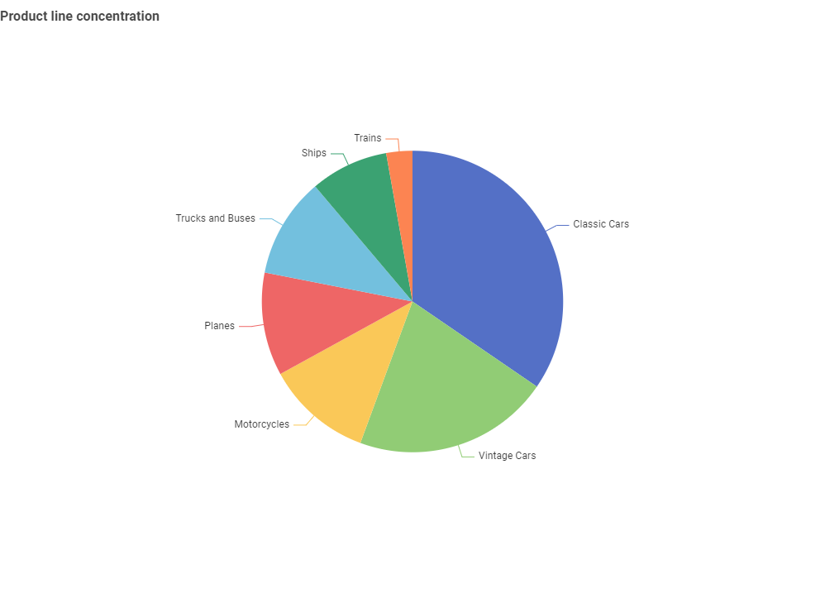
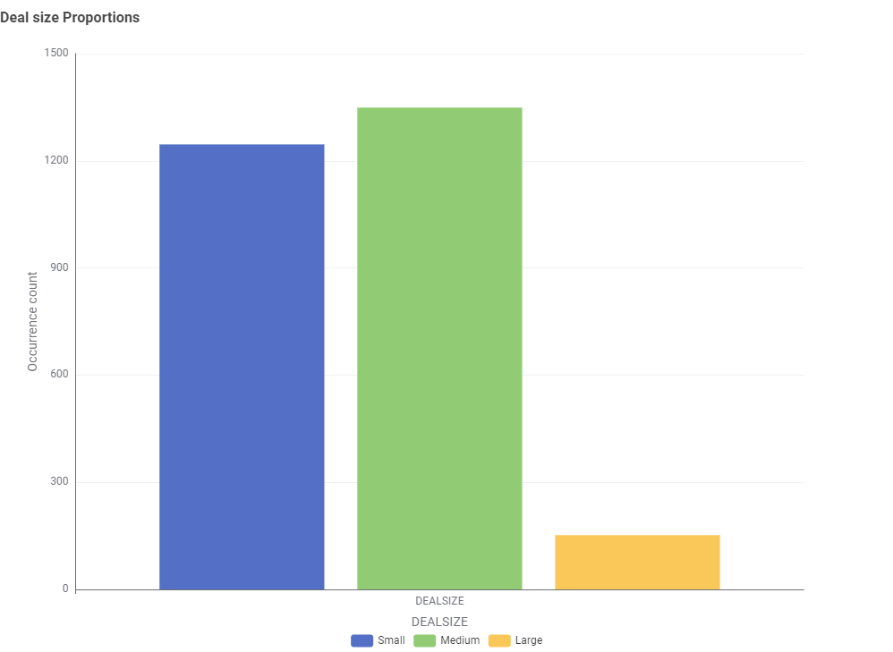
EDA & Inferences – UniVARIATE analysis
From the pie chart for the product line, we can conclude that
Classic cars are the popular product followed by vintage cars and other.
As more of customer concentration is for classic cars so we must focus on that for business growth
From the bar chart of Deal Size, we can conclude that
More business is coming from the medium and small size deals.
Its seems that customer choose the large sized deals are very less comparing to the small and medium sized deals.

Slide 9
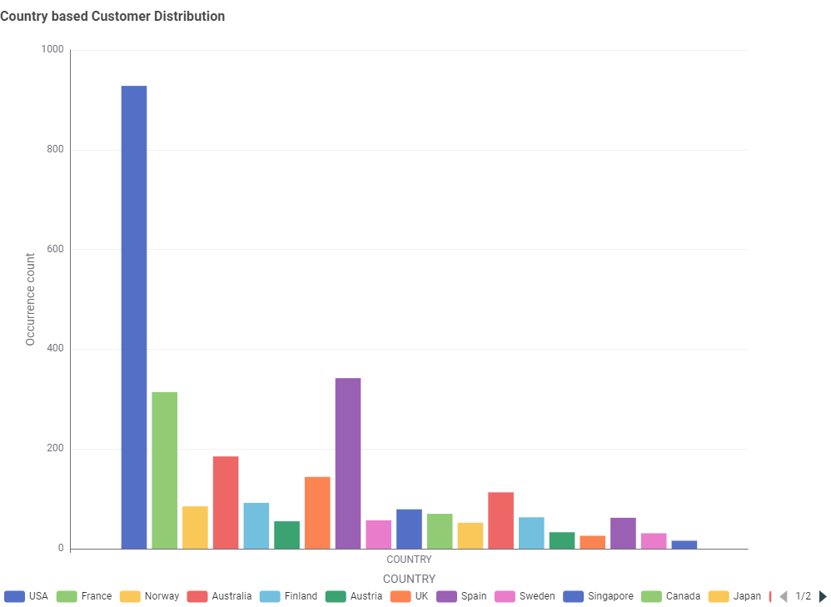
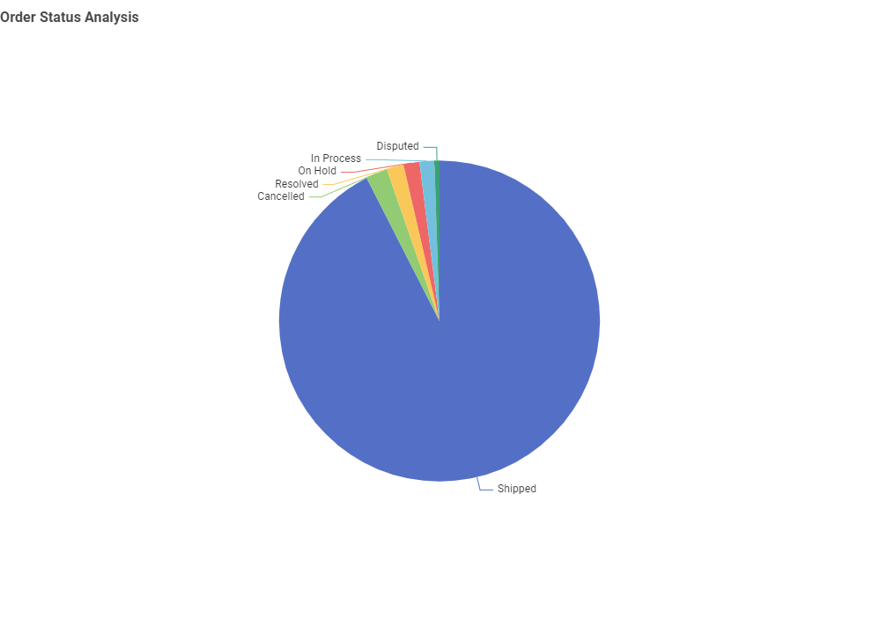
EDA & Inferences – UniVARIATE analysis
From the Bar chart for customer distribution globally, we can conclude that
Large number of customers are from USA followed by Spain, France and other countries.
Doing Business across 19 countries.
From the Pie chart of order status, we can conclude that
Most of order are shipped but still cancelled order cover 2.19% of total order.
We must focus on resolved and hold order to speed the process so that it will ship to customer on time.

Slide 10
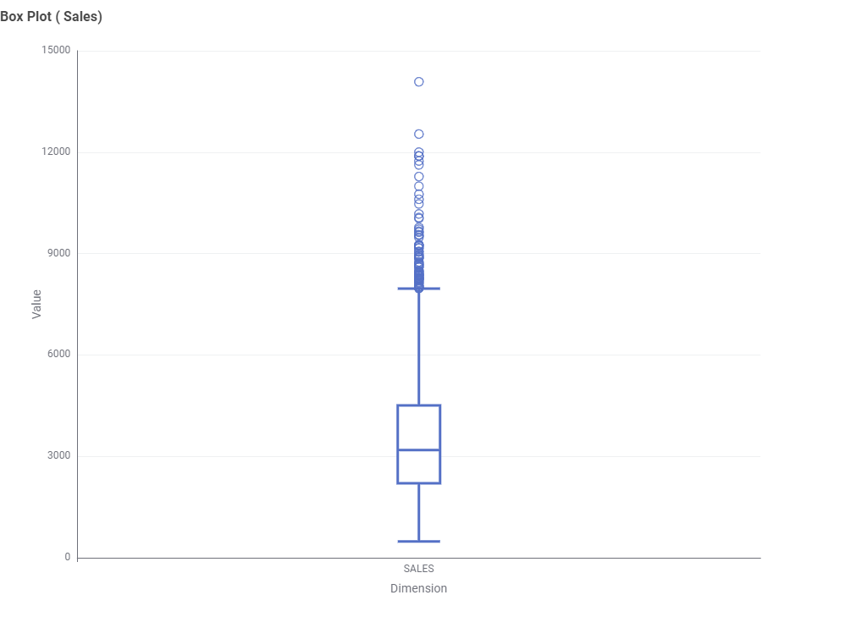
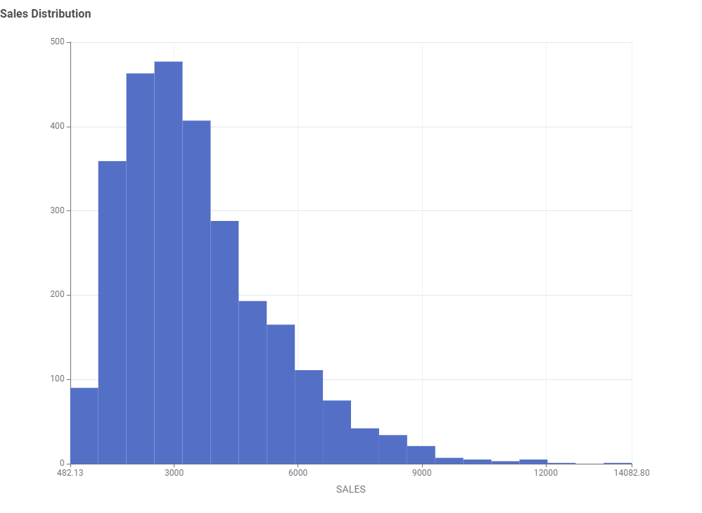
EDA & Inferences – UniVARIATE analysis
From the Box Plot for sales, we can conclude that
• 50% of sales are concentrated between $2.2K to $4.5K.
• There seems to be few outliers present.
• Minimum sales value was $482 and Maximum sales values was $8K.
From the Histogram sales distribution, we can conclude that
• Most of sales are concentrated from range $1.5K to $6K.
• There seems to be few outliers present

Slide 11
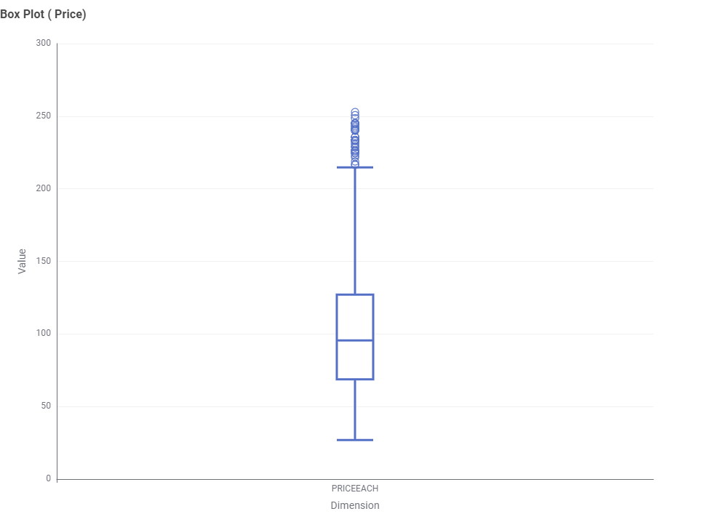
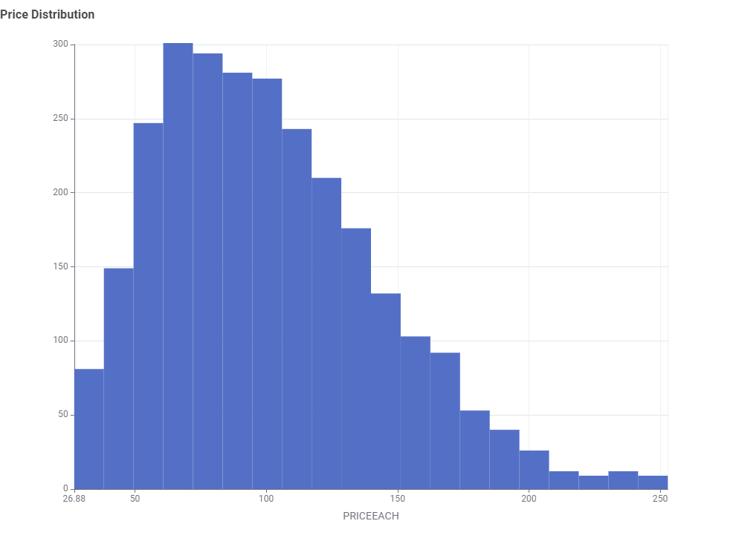
EDA & Inferences – UniVARIATE analysis
From the Box Plot for Price value, we can conclude that
• 50% of product has price range concentrated between $68 to $127.
• There seems to be few outliers present.
• Minimum sales value was $27 and Maximum sales values was $215.
From the Histogram price distribution, we can conclude that
• Most products fall in Price range of $50 to $150.
• There seems to be few outliers present

Slide 12
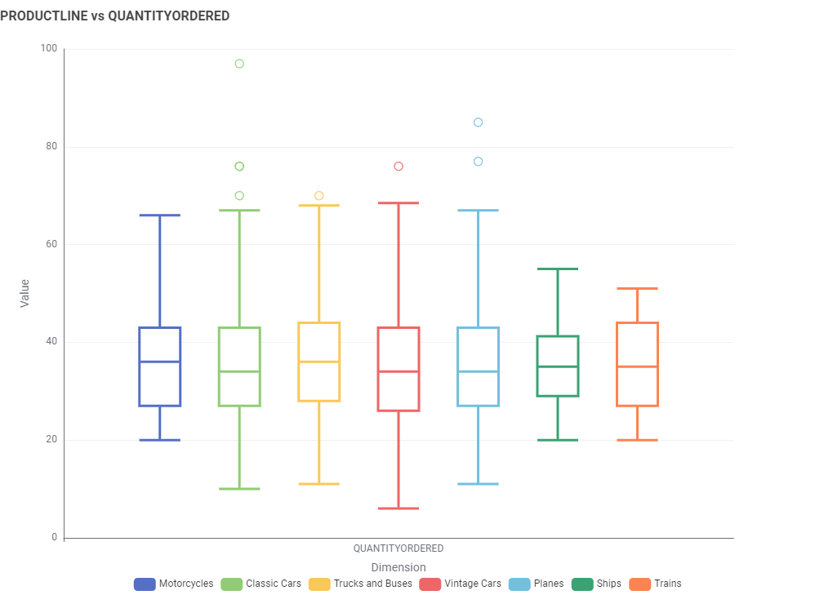
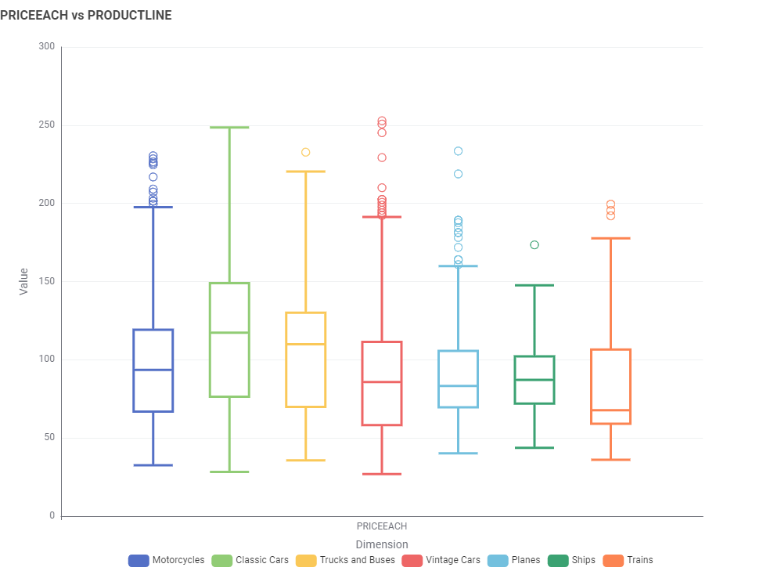
EDA & Inferences – bivariate analysis
From the Box Plot between Product line & quantity Ordered, we can conclude that
• Most product categories show similar median order quantities (around 34-36 units), this suggests relatively consistent ordering patterns across product lines
• There are notable outliers but classic cars show more significant outliers followed by planes.
• Vintage Cars and Planes show the widest spread in order quantities.
From the Box Plot between Product line & Price each, we can conclude that
• Product categories shows different median prices, this suggests non consistent pricing across product line.
• Vintage Cars, motorcycles and Planes show the widest spread in price value.
• There are notable outliers in a product category except classic cars.

Slide 13
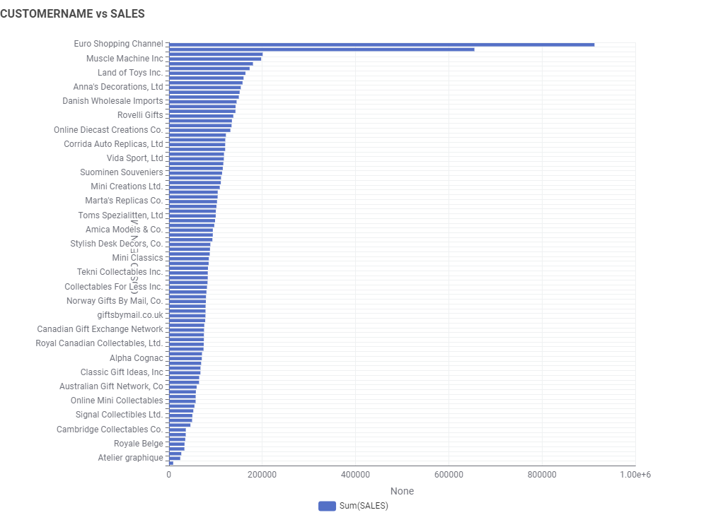
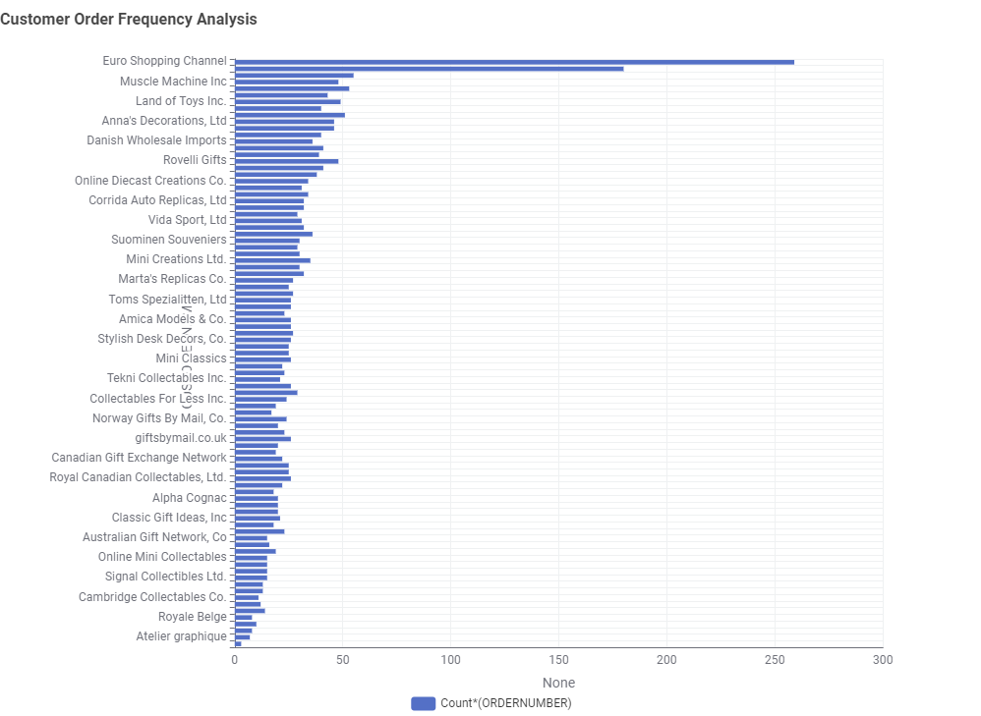
EDA & Inferences – bivariate analysis
From the bar chart between customer name and sales, we can inference that
• Euro Shopping Channel was the top customer with the highest sales value followed by Mini Gifts Distributor ltd.
• Most customers had made purchase within $200K.
• Boards & Toys co. is customer which give lowest sales value.
From the bar chart between Customer name and order frequency, we can inference that
• Euro Shopping Channel was the top customer with the highest orders followed by Mini Gifts Distributor ltd.
• Order frequency range in which most customers fall under 55.
• Boards & Toys co. is customer with lowest order frequency.

Slide 14
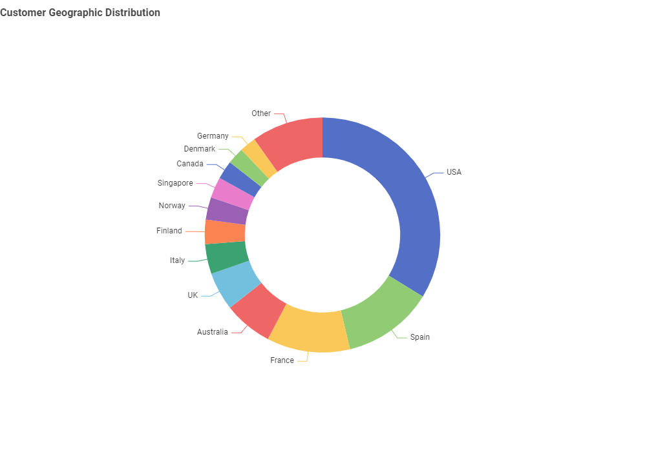
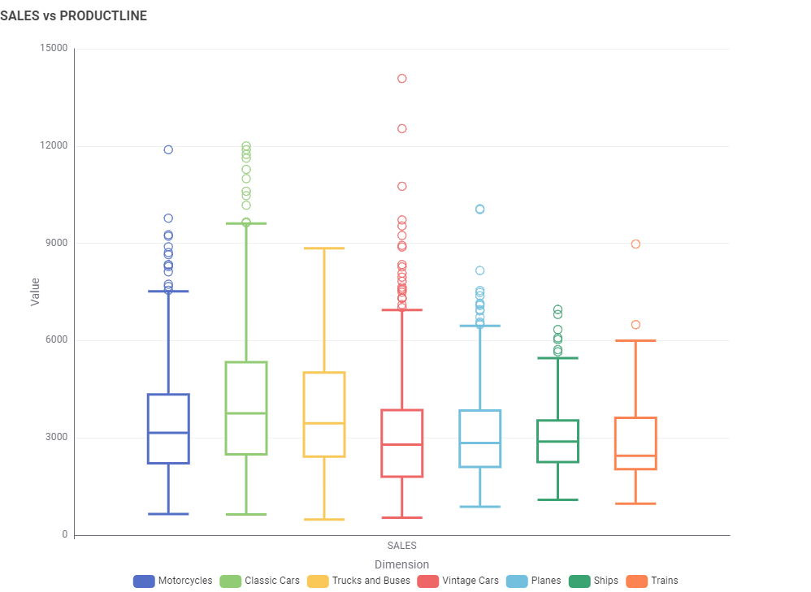
EDA & Inferences – bivariate analysis
From the Pie chart of customer distribution in Country, we can conclude that
Most of Customers belongs to USA with 34% contribution to total data.
There are seven countries that contribute Less than 2%.
Spain Contribute 12.5% and France Contribute 11.4%.
USA, Spain & France cover 50% of customer base.
From Box plot between Sales & Product line, we can conclude that
Classic Cars shows the highest median sales and most frequent high-value transactions.
Focus marketing efforts on Classic Cars and Vintage Cars for maximum revenue impact.
The high outliers in Vintage Cars suggest potential for premium pricing strategies.
Planes and Ships have more concentrated sales distributions, suggesting more consistent pricing or order patterns.

Slide 15
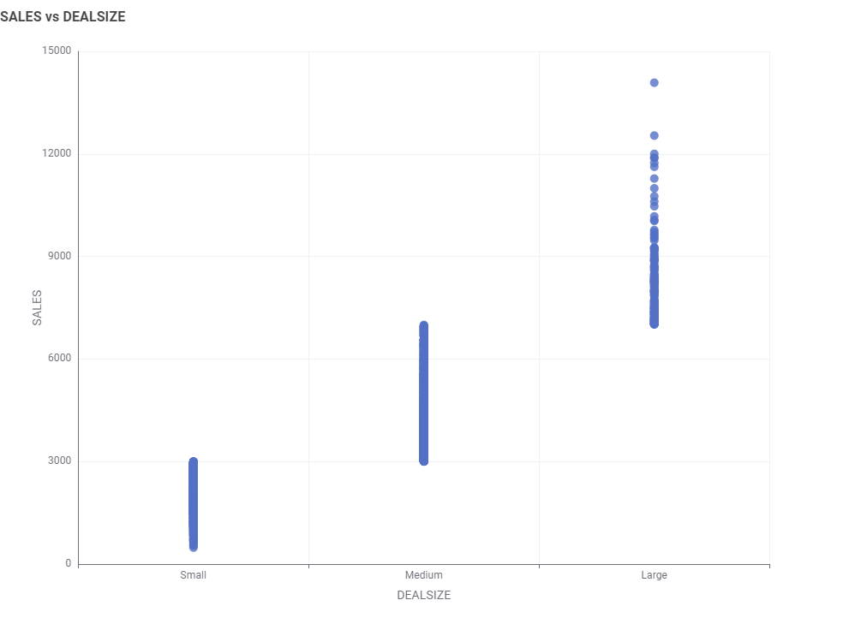
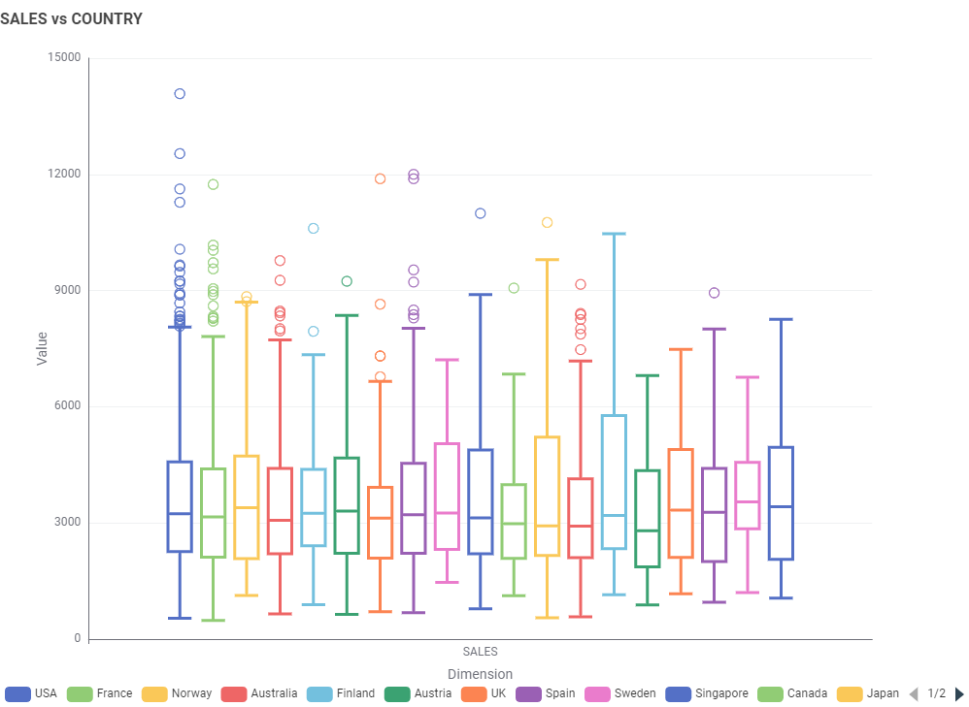
EDA & Inferences – bivariate analysis
From Scatterplot between Sales & Deal size, we can conclude that
There appears to be a positive correlation between deal size and sales.
The business might want to focus on increasing the number of large deals, as they seem to generate higher sales volumes.
There are a few high-performing large deals that stand out above the rest, which might be worth analyzing for replication.
3 distinct deal sizes: Small, Medium, & Large.
From Box plot between Sales & Country, we can conclude that
• Some countries, such as the USA, France, and Norway, show higher maximum sales values.
• Several countries have outliers, suggesting exceptional sales performances in these markets.
• Countries with higher max sales but lower medians (e.g., Singapore, Canada) might represent potential for growth.

Slide 16
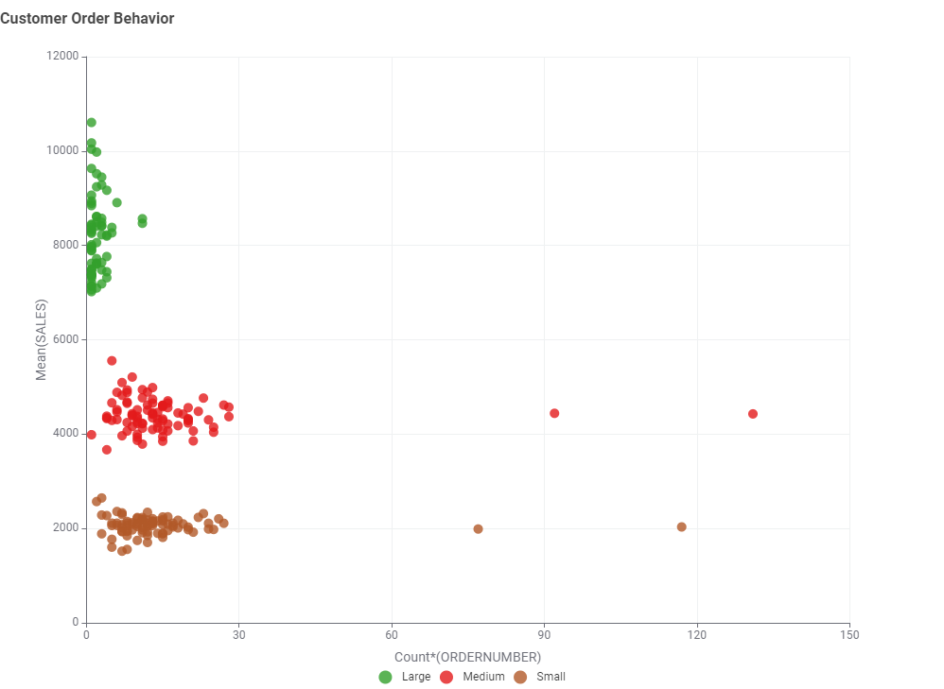
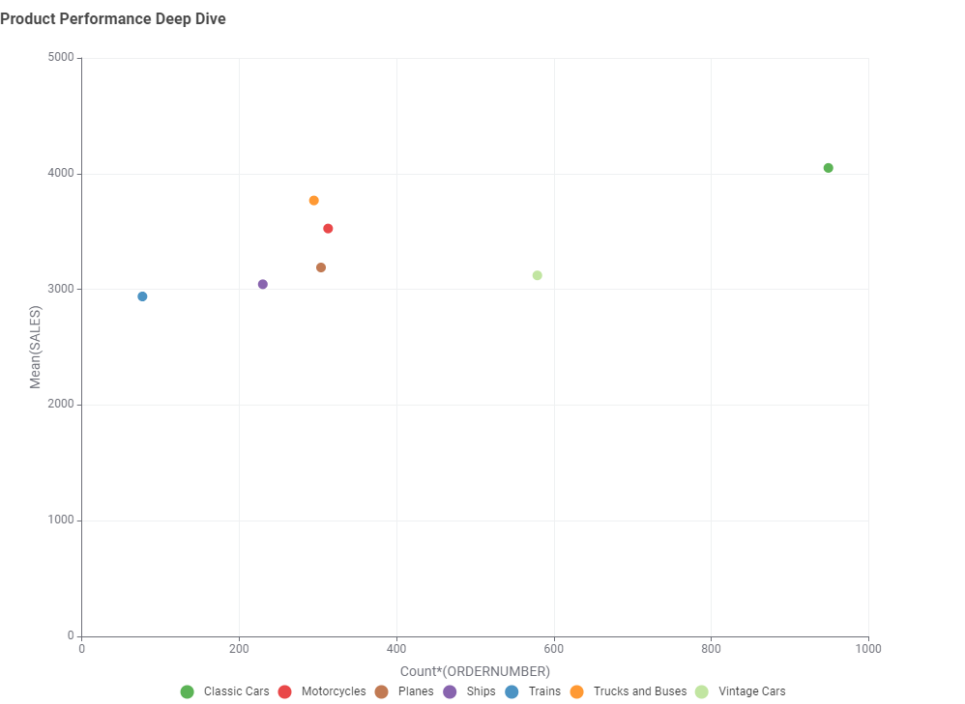
EDA & Inferences – multivariate analysis
From Customer Order Behavior plot, insights are
Large orders have the highest mean sales but occur less frequently. Small orders have the lowest mean sales but are the most numerous.
The majority of high value orders come from customers with fewer total orders, suggesting that big spenders aren't necessarily frequent buyers.
A diverse customer base that includes both high-value and high frequency purchasers
From Product Performance Deep-Dive plot, insights are
Classic Cars have the highest number of orders, indicating strong customer demand.
Motorcycles show a good balance between order volume & mean sales value, potentially representing a stable & profitable product line.
Despite lower order volumes, categories like Vintage Cars, Trucks & Buses show high mean sales values, suggesting they may be premium items.

Slide 17
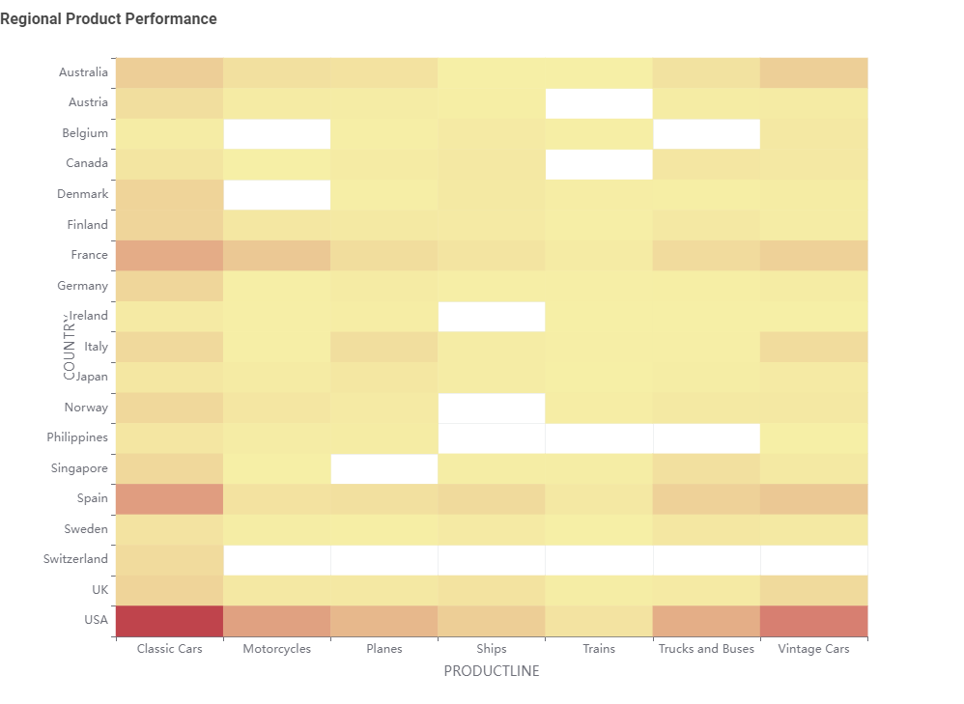
EDA & Inferences – multivariate analysis
From Regional Product Performance plot, insights
• The USA stands out as the strongest market across all product lines.
• Classic Cars appear to be the best performing product category across most countries, indicating a globally popular product line.
• European countries like France, Spain, & Germany show strong performance across multiple product categories.
• Several countries show no data for certain product lines, suggesting potential markets.

Slide 18
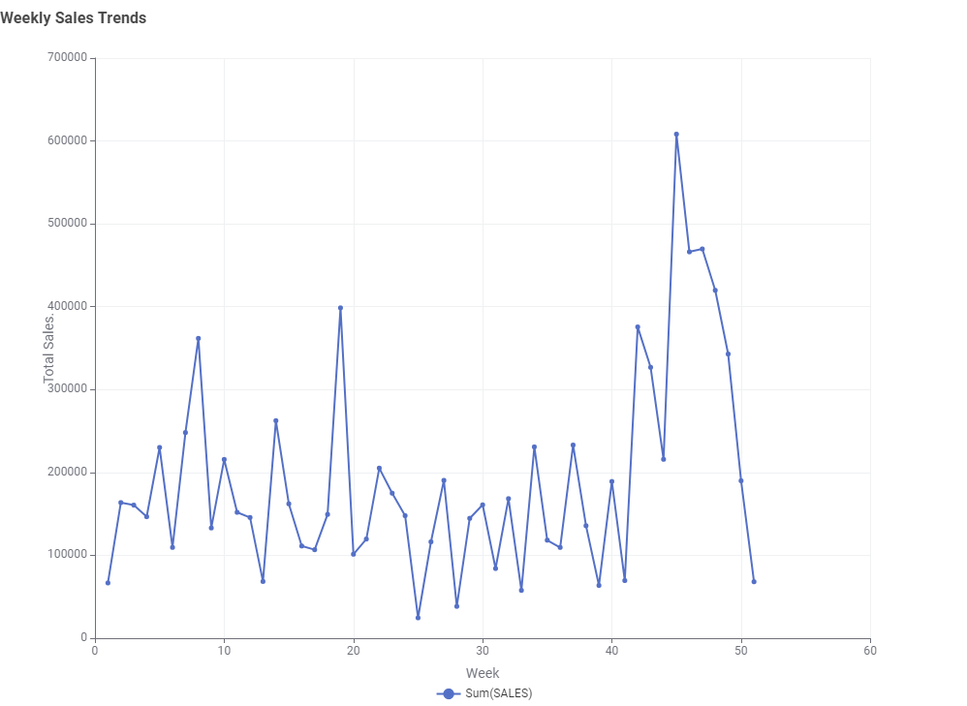
EDA & Inferences –Time Series analysis
Insights form Weekly Sales Trends plot:
• Sales show extreme fluctuations week to week, indicating an unstable or highly seasonal business.
• The highest sales peak occurs around week 45. This suggests a potential seasonal high point or successful marketing campaign.
• There seems to be a repeating pattern of peaks and troughs, possibly aligned with monthly or quarterly cycles.

Slide 19
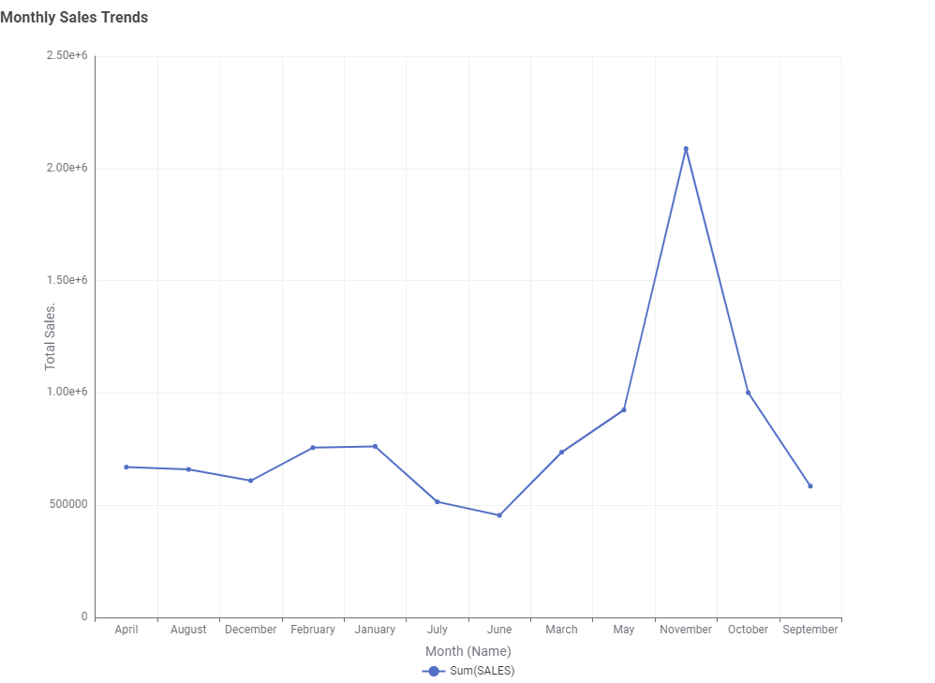
EDA & Inferences –Time Series analysis
Insights form Monthly Sales Trends plot:
There's a significant sales spike in November compared to other months. This suggests a strong seasonal trend, possibly due to holiday shopping.
June & July show the lowest sales figures, pointing to a potential off-season that may require targeted marketing or product diversification.
From July to November, there's a steady increase in sales.

Slide 20
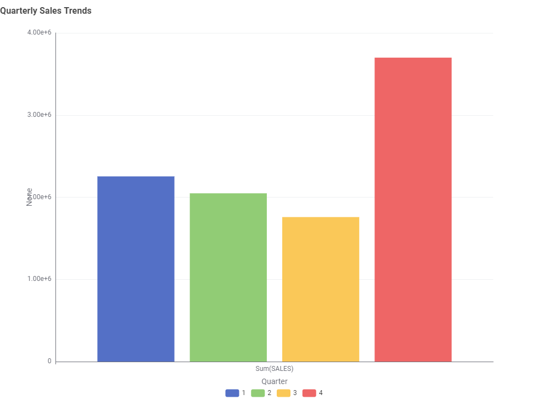
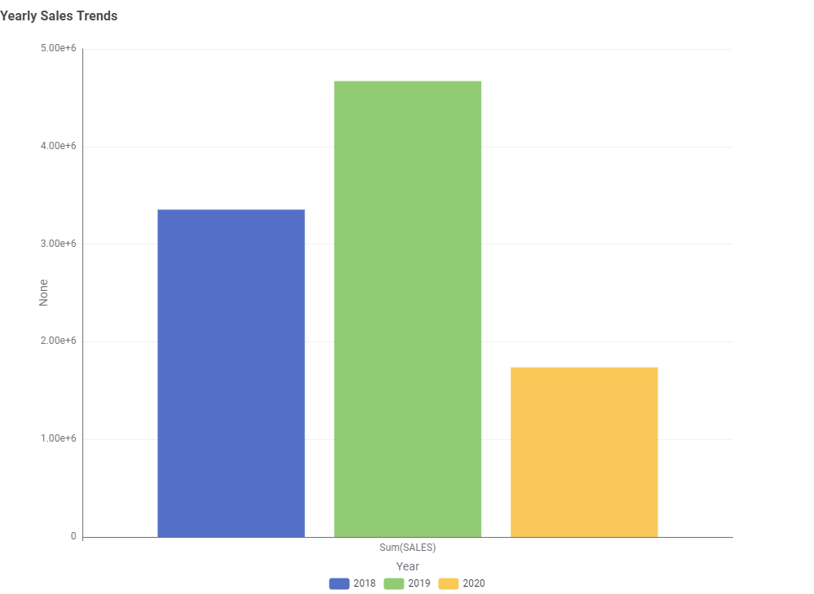
EDA & Inferences –Time Series analysis
Insights form Quarterly Sales Trends plot:
The fourth quarter significantly outperforms all others, with sales nearly double that of Q1. This indicates a strong seasonal trend, likely driven by holiday shopping.
Q3 shows the lowest sales, suggesting a potential off-season that may require targeted strategies to boost performance.
Insights form Yearly Sales Trends plot:
• Sales reached their highest point in 2019, showing significant growth from 2018.
• There's a sharp drop in sales in 2020, falling below even 2018 levels. This could be due to external factors.

Slide 21
EDA & Inferences –Time Series analysis
Conclusion:
• The business shows consistent seasonal trends but is vulnerable to yearly fluctuations. Success depends on maximizing Q4 sales, smoothing off peak periods, and building resilience against economic shocks. Strategies may include diversification, market expansion, and year-round customer engagement.
Customer Segmentation using RFM analysis
What is RFM?
RFM stands for Recency, Frequency, and Monetary analysis. It is a customer segmentation technique used to evaluate and group customers based on their purchasing behavior:
Recency (R): How recently a customer has made a purchase.
Frequency (F): How often a customer makes purchases.
Monetary (M): How much a customer spends.
Parameters & Assumptions
Used KNIME tool for RFM Analysis and also include all customers provided in dataset.
1. Recency: Days since the last purchase (DAYS_SINCE_LASTORDER).
Assumption: Customers with lower values are more engaged.
2. Frequency: Number of orders per customer (ORDERNUMBER).
Assumption: Higher order counts indicate loyal customers.
3. Monetary: Total sales per customer (SALES).
Assumption: Higher spenders are more valuable.

Slide 22
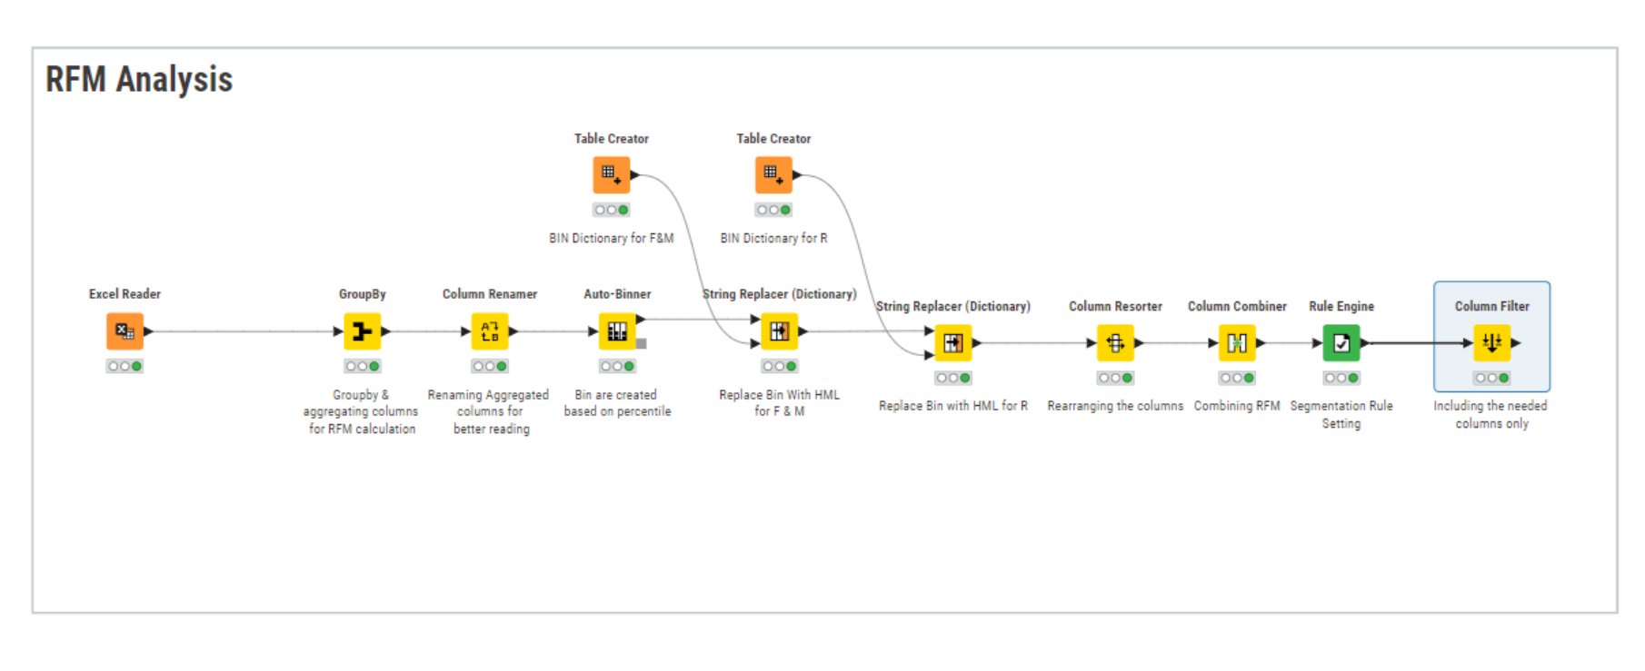
Customer Segmentation using RFM analysis
KNIME workflow image

Slide 23
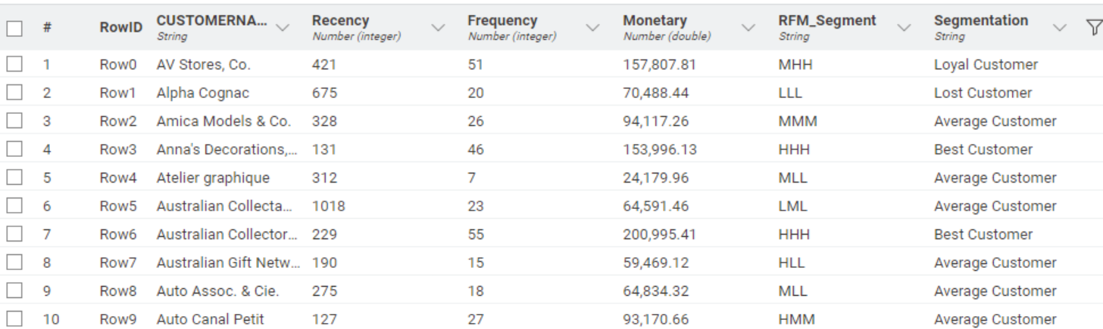
Customer Segmentation using RFM analysis
Output Table

Slide 24
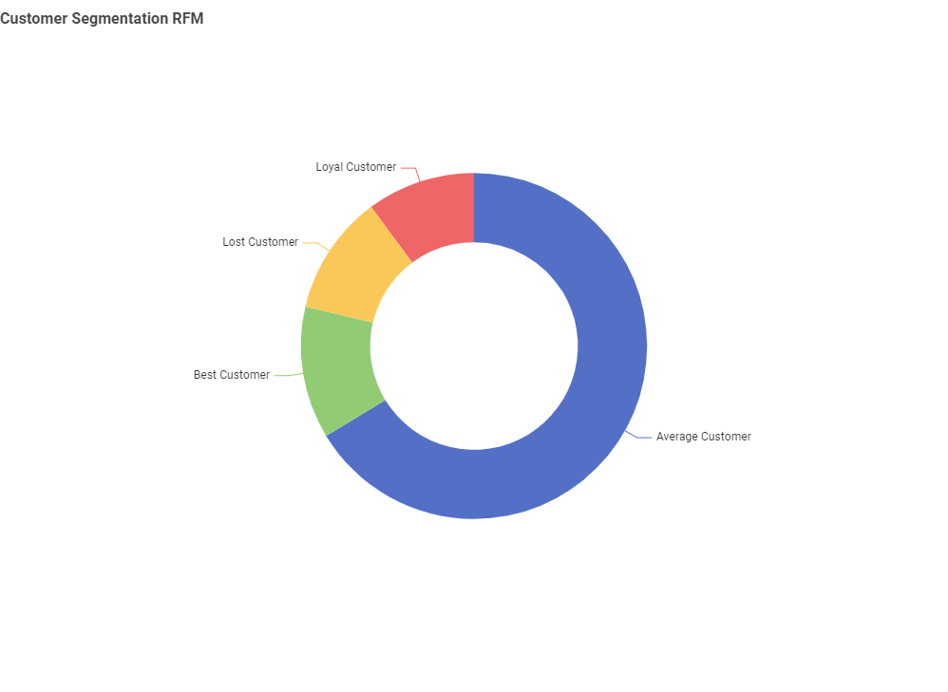
Customer Segmentation using RFM analysis
Inferences from RFM Analysis and identified segments
After conducting the RFM analysis, we have classified customers into four segments based on their purchasing behavior.
Customer are segmented into four groups
• Best Customer
• Loyal Customer
• Average Customer
• Lost Customer
Best Customer: HHH (High Recency, Frequency & Monetary).
Loyal Customer: MHH / LHH (High Frequency & Monetary).
Lost Customer: LLL (Low Recency, Frequency & Monetary).
Average Customer: All other combination except the above mentioned.

Slide 25
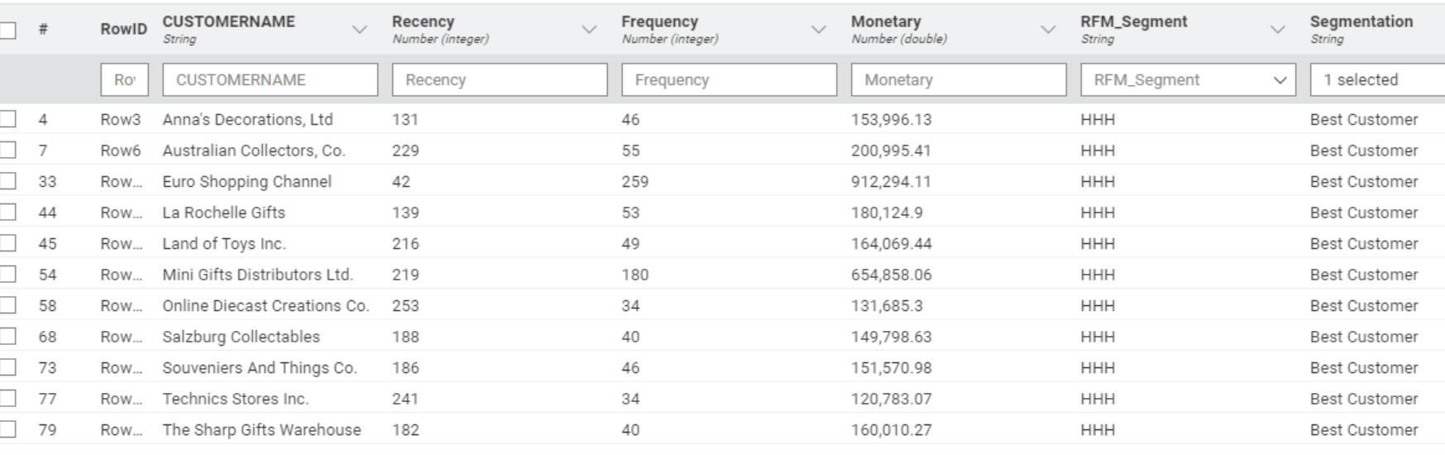
Customer Segmentation using RFM analysis
Best Customers
These customers have high Recency, Frequency, and Monetary scores, indicating that they purchase frequently, spend generously, and have made recent transactions.

Slide 26
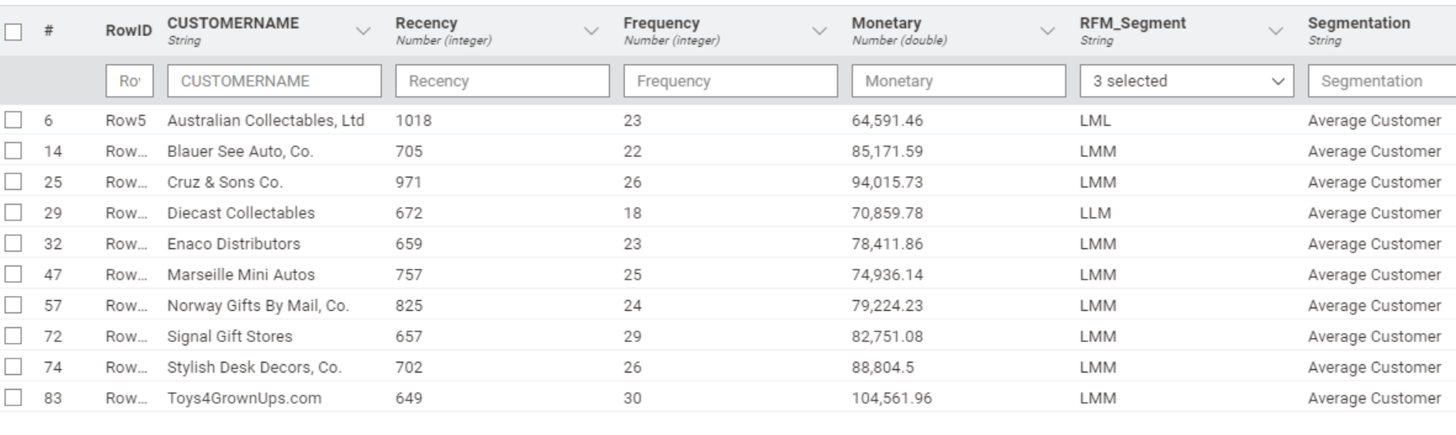
Customer Segmentation using RFM analysis
Customers on the Verge of Churnings
These customers have moderate Frequency and Monetary scores but low Recency scores, indicating that they have not made a purchase recently and might churn soon.

Slide 27
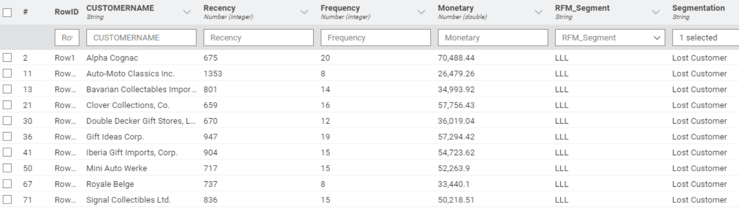
Customer Segmentation using RFM analysis
Lost Customers
These customers have low scores for Recency, Frequency, and Monetary, indicating minimal engagement and likely Lost.

Slide 28
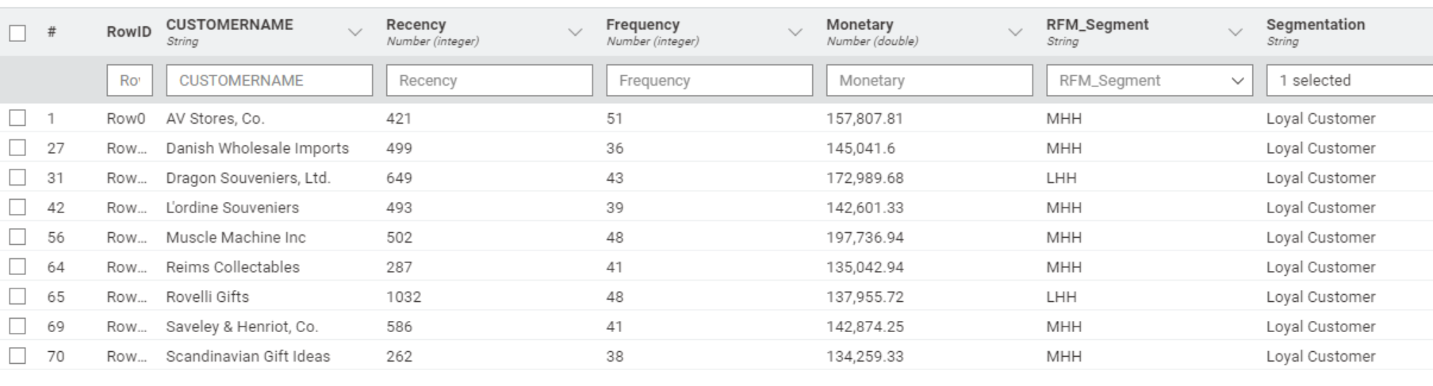
Customer Segmentation using RFM analysis
Loyal Customers
These customers have consistently high Frequency and Monetary scores, reflecting their loyalty to the business.

Slide 29
Customer Segmentation using RFM analysis
Recommendations
• Best Customers: Offer exclusive perks, discounts, or loyalty rewards to retain these customers.
• Customers on the Verge of Churning: Re-engage through targeted email campaigns, offering personalized discounts or promotions.
• Lost Customers: Attempt to win them back with special “Miss You" campaigns or seek feedback to understand why they stopped engaging.
• Loyal Customers: Continue nurturing these relationships with VIP programs and regular communication to maintain their loyalty.

Slide 30
Part B
Problem Statement
Data Overview
Exploratory Data Analysis
Time – Series Analysis
Product Analysis
Market Basket Analysis
Relevance
KNIME Workflow Image
Threshold Values of Support & Confidence
Associations Identified
Metrics Explanation
Suggestion of Possible Combos & Offers
Recommendations
High-Frequency Item Combos
Complementary Product Discounts
Bundled Combos for Regular Items
Weekend Deals for Impulse Purchases
Buy One, Get One (BOGO) Offers
Seasonal Combos

Slide 31
Problem Statement
A grocery store shared the transactional data with you. Your job is to conduct a thorough analysis of Point of Sale (POS) data, identify the most commonly occurring sets of items in the customer orders, and provide recommendations through which a grocery store can increase its revenue by popular combo offers & discounts for customers.
Data Overview
Dataset Contains one sheets namely [‘dataset group']. Which contains 3 Columns & 20641 Rows. There are no missing values. Date column need to altered to correct format.

Slide 32
EDA
Performed exploratory analysis and list out the insights from them.
Tool Used: KNIME
Total No. Of Sales Records = 20641.
Dataset have 3 Columns.
No Missing Entries.
Zero Duplicate Entries.
Dataset has records from 1st Jan 2018 to 26th Feb 2020.
There 37 Range of Products.
Maximum transactions of 113 were made on 8th Feb 2019.
Average number products brought in an order was 18.
Store did not provided data for Q4 (Oct, Nov & Dec), So lets assume the store was closed during Q4.
Poultry was highest ordered product.
Hand soap was the least ordered product.

Slide 33
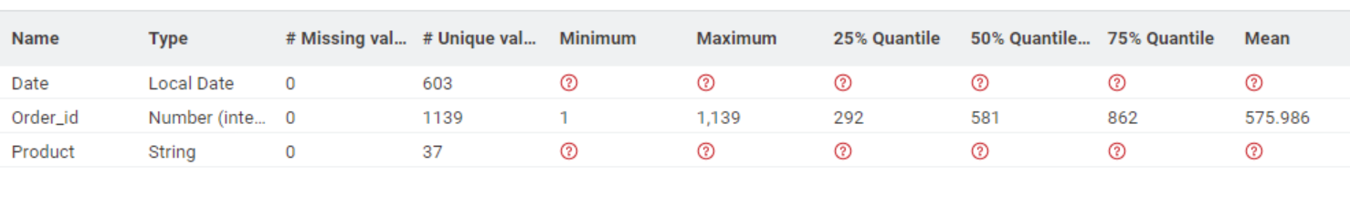
EDA
Statistical Summary:
1139 Number of Invoice and its retailed data was provided.
Comparing of days of week Monday and Tuesday seems to have lowest transaction.
Dataset do not have data 26th Feb 2020, may be store was closed because or Corona Pandemic.

Slide 34
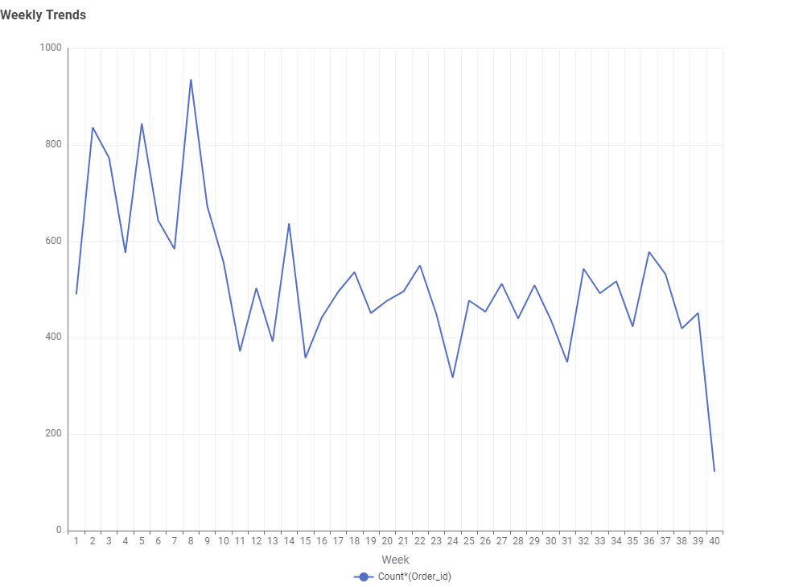
EDA
Insights from Weekly Trends:
• The metric experiences major week-to-week fluctuations, indicating high variability in the business performance, which could be influenced by factors like seasonality, promotions, or other external events.
• The overall trend shows a gradual decline in the metric over the time period shown.

Slide 35
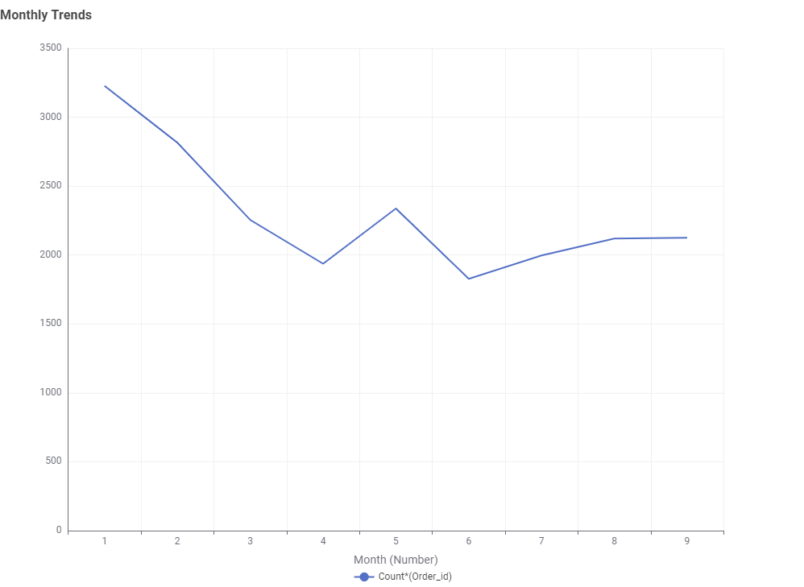
EDA
Insights from Monthly Trends:
• The metric exhibits large month-to-month variations, with sharp peaks and valleys throughout the time period.
• The overall trend shows a gradual decline in the metric's value, suggesting a downward trajectory in the business performance.

Slide 36
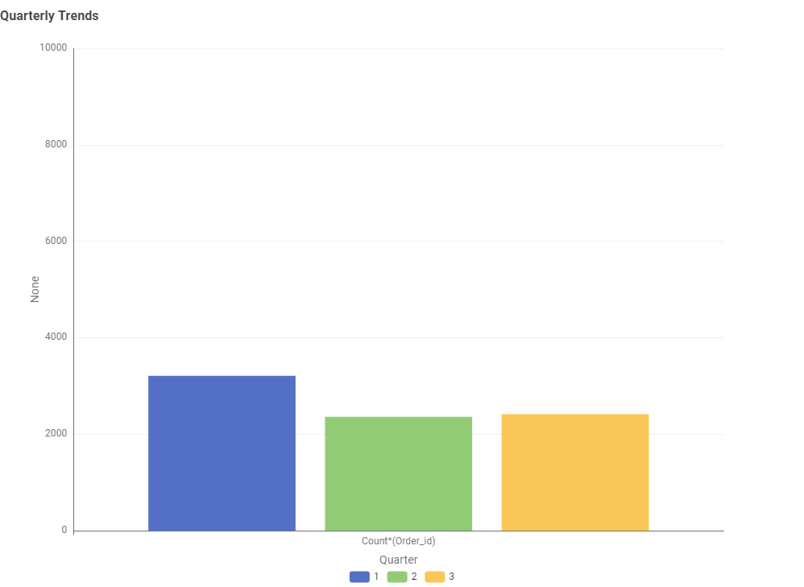
EDA
Insights from Quarterly Trends:
• The metric shows large differences in value across the three quarters presented, indicating substantial quarter-to-quarter fluctuations.
• The first quarter has the highest metric value, significantly higher than the other two quarters shown.
• The variations in quarterly values suggest the business may experience seasonal patterns, with a stronger performance in the first quarter compared to the others.
• Note – Q4 Data was not provided.

Slide 37
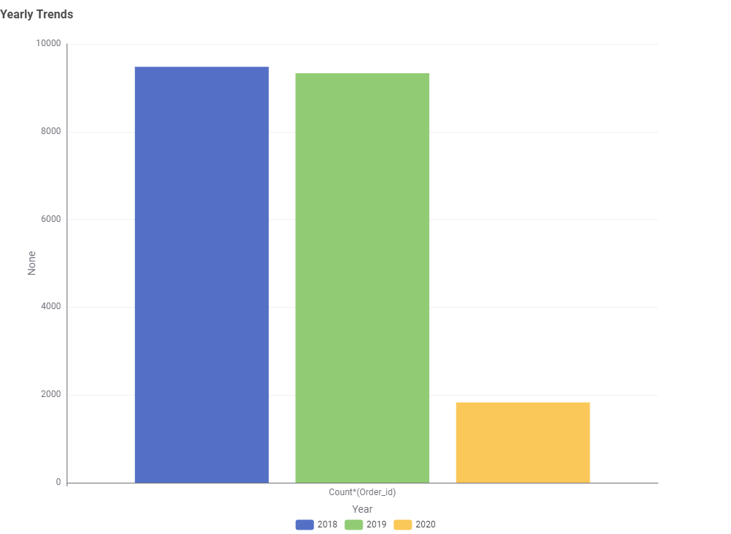
EDA
Insights from Yearly Trends:
• The metric has Decreased substantially from 2018 to 2019, indicating Poor year-on-year performance improvement.
• Large Fall can be seen in 2020, that may be due to some external factor like Corona Pandemic.
• Note – Only first two-month data was available for year 2020.

Slide 38
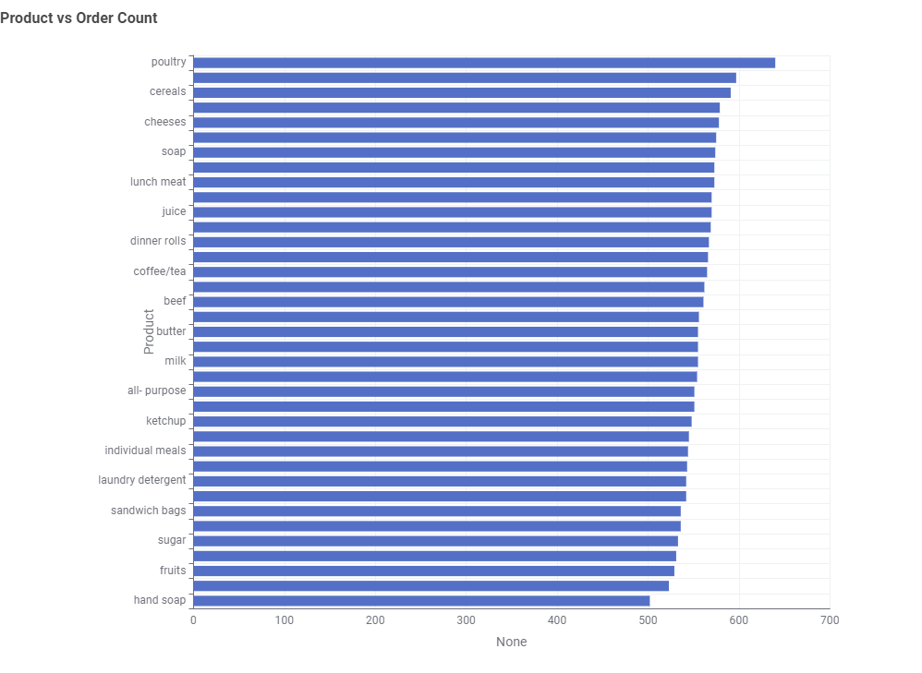
EDA
Key insights from the "Product vs Order Count" plot:
• The products with the highest order counts are poultry, cereals, and cheeses, indicating these are the top selling items.
• Categories like lunch meat, juice, and dinner rolls show moderate order counts, suggesting they are reasonably popular products.
• Items like sugar, fruits, and hand soap have relatively lower order counts, implying they may be slower moving products.

Slide 39
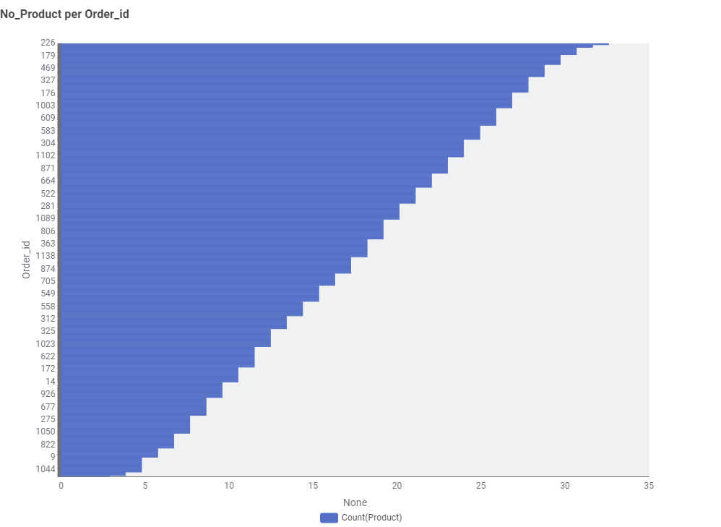
EDA
The plot shows the distribution of the number of products per order ID. Here are the key insights:
• The plot indicates that the majority of orders have a relatively high number of products, with the counts extending up to 34 products per order.
• The wide range of product counts per order implies there may be room to optimize the average basket size, either by encouraging customers to add more items or by identifying ways to reduce the number of single item orders.
• The high product counts per order could have implications for inventory management, warehouse operations, and logistics, as the business needs to ensure efficient order processing and fulfillment for these multi-item orders.

Slide 40
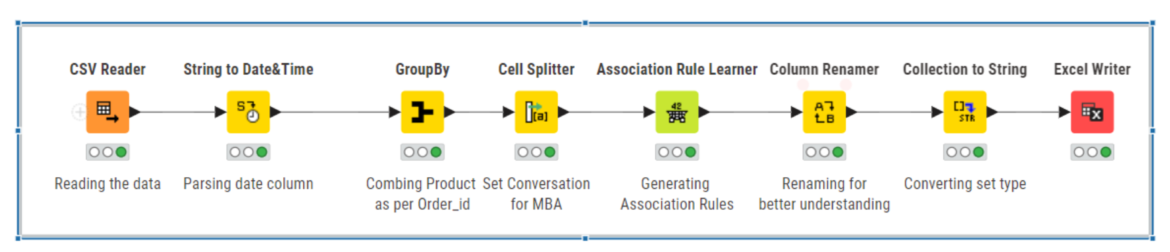
Market Basket Analysis
Market Basket Analysis (MBA) is a data mining technique used to uncover relationships or associations between items in a dataset. It helps identify products that are frequently bought together. In this case, MBA is crucial for understanding customer buying patterns in a grocery store.
Relevance
• Combo Offers: By identifying frequently bought item sets, the grocery store can create combo offers or discounts that encourage customers to buy more.
• Store Layout: Items often purchased together can be strategically placed nearby to increase impulse buying.
• Personalized Promotions: Offers can be tailored based on customer purchase history to increase loyalty and sales.
KNIME Workflow Image

Slide 41
Market Basket Analysis
Threshold Values of Support & Confidence
Support:
• Represents how frequently an itemset occurs in the dataset.
• Example: A support of 0.05 means the itemset appears in 5% of transactions.
• Used Value: I used support value as 0.02 as it helps focus the analysis on the most frequent patterns in the data.
2. Confidence:
• Measures the likelihood of the second item being purchased when the first item is already in the basket.
• Example: A confidence of 0.8 means there is an 80% chance of buying item B given item A was purchased.
• Used Value: I used 0.65 as it helps focus the analysis on the more reliable and actionable association rules.

Slide 42
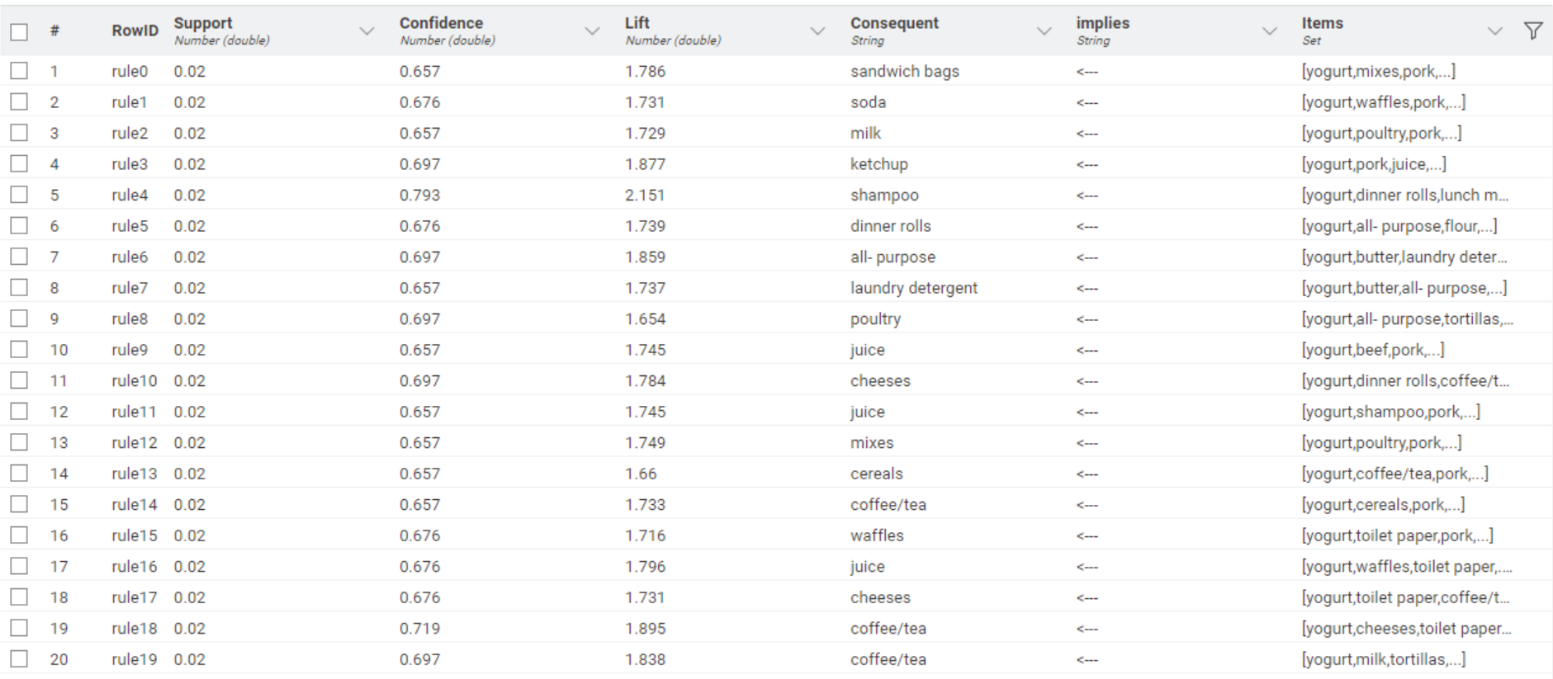
Associations Identified
The associations identified, below is output from the “Association Rule Learner Node” output:

Slide 43
Associations Identified
Explain about support, confidence, & lift values that are calculated
Support:
Measures how frequently the itemset (antecedent and consequent) appears in the dataset.
Formula: Support=Transactions with Antecedent and Consequent/(TotaL Transaction)
Interpretation: A support of 0.02 for "Yogurt → Sandwich Bags" means 2% of all transactions include both items.
Confidence:
Represents the probability of purchasing the consequent item(s) given that the antecedent item(s) are purchased.
Formula: Confidence=Transactions with Antecedent and Consequent/(Transaction with Antecedent)
Interpretation: A confidence of 0.65 for "Yogurt → Sandwich Bags" indicates that 65% of customers who bought yogurt also bought sandwich bags.
Lift:
Measures the strength of the rule over random co-occurrence of items.
Formula: Lift=Confidence/(Support of Consequent)
Interpretation: A lift greater than 1 implies a positive association between the items. For "Yogurt → Sandwich Bags," a lift of 1.78 indicates that the items are 78% more likely to be bought together than by chance.

Slide 44
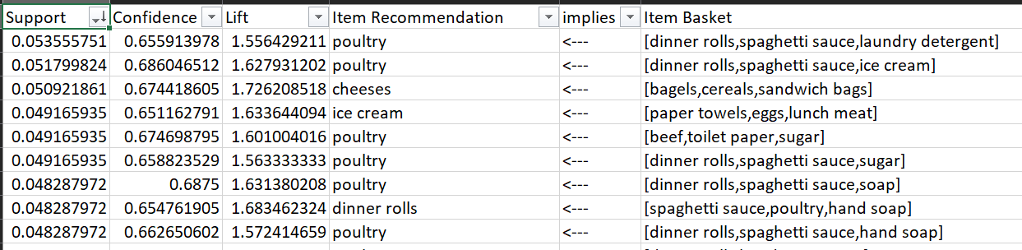
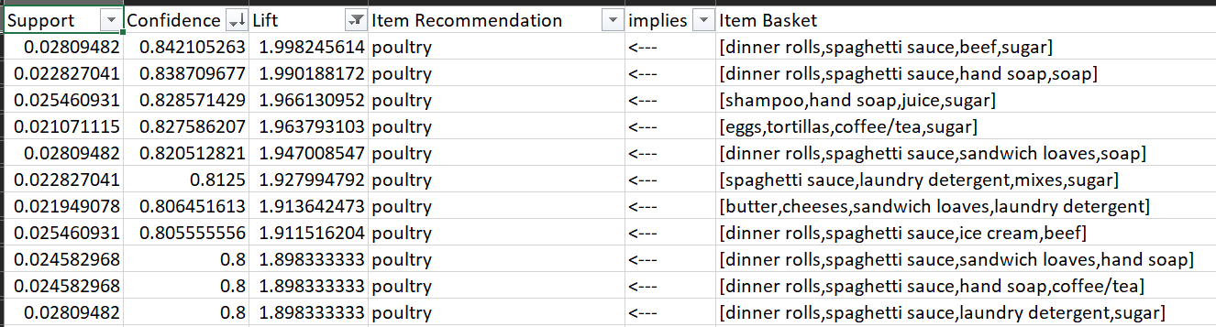
Suggestion of Possible Combos & Offers
Recommendation
Based on the associations identified in the Market Basket Analysis, here are specific combo suggestions and promotions that the grocery store can implement to drive sales and improve customer satisfaction:
1. High-Frequency Item Combos
Item combinations with the highest Support. Below are the top 10 list,
2. Complementary Product Discounts
Item pairs with high Confidence and moderate Lift. These indicate strong but not overly coincidental relationships. Below was top 10 list that has high confidence and moderate lift ( lift >1.5 &<2).

Slide 45
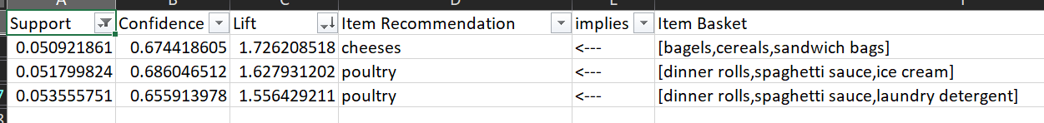
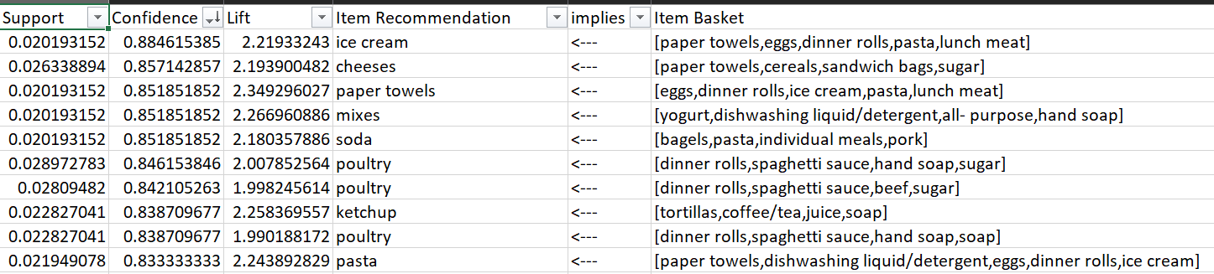
Suggestion of Possible Combos & Offers
3. Bundled Combos for Regular Items
Target pairs with both high Support and Lift, as these are strong associations. Below was list of items that has support > 0.05 and lift >1.5.
4. Weekend Deals for Impulse Purchases
Item pairs with high Confidence and moderate Lift. These indicate strong but not overly coincidental relationships. Below was top 10 list that has high confidence and moderate lift ( lift >1.5 &<2).

Slide 46
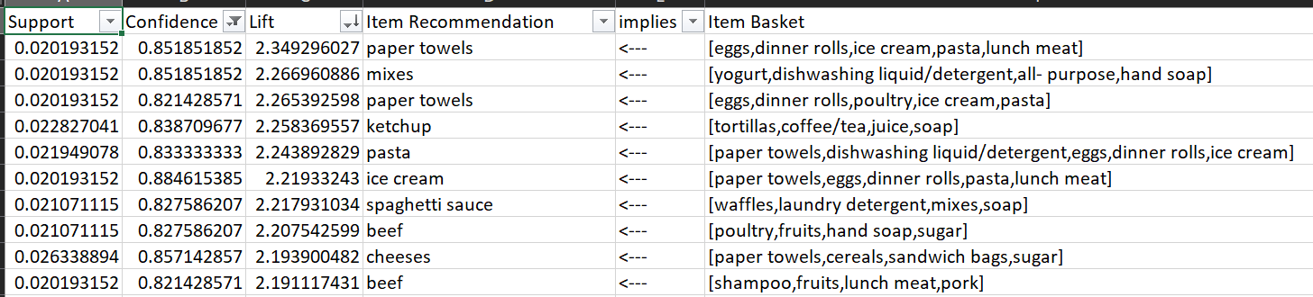
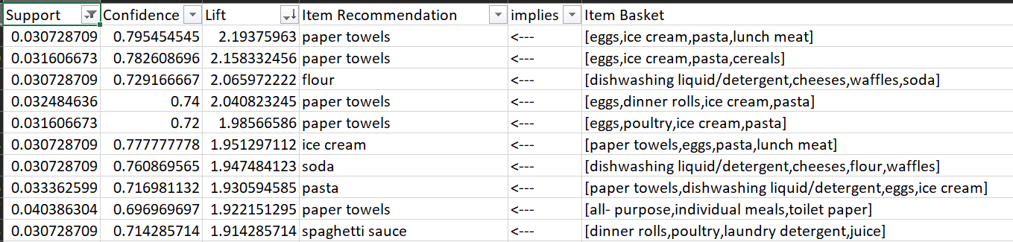
Suggestion of Possible Combos & Offers
5. Buy One, Get One (BOGO) Offers
Combinations where one product strongly implies another (Confidence > 0.8) and has a high Lift value, below are list of those combinations (Confidence > 0.8 and Lift > 1.5)
6. Seasonal Combos
Item pairs where Support is moderate but the combination is unique (high Lift).

Slide 47

Thank you

